Slide 1


Energy Modeling for Green Computing Locations
Mentors : Prof. Mel Devine (UCD) and Brian Minehane (Novartis)

Slide 2

Data Centre: The world's largest Internet services are supported by data centres, which are warehouse-sized computer systems that operate constantly to support the IT industry.
Carbon emission
Data centers are responsible for 2% of overall U.S. Greenhouse gas emissions.
Manufacturer PCF
Increasingly generating (PCF) reports to quantify and disclose the environmental impact of their products throughout their lifecycle.
Introduction
Sustainable Data centres
Embrace energy-efficient infrastructure, transition to renewables like solar and wind, and deploy advanced monitoring for sustainable data center operations.

Slide 3
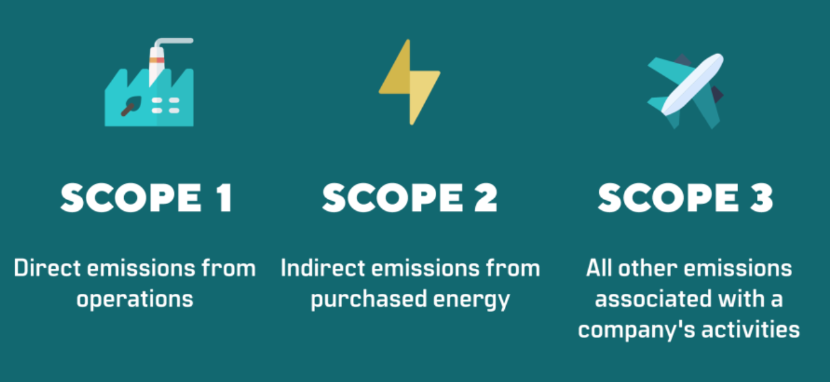
Sustainability Within Novartis
2030
Carbon Neutral across the value chain (Scope 1, 2 & 3)
2025
2040
Carbon neutral own operations (Scope 1 and 2)
Net-zero
Scope Definition by GHG Protocol.
Novartis aligns their efforts with the SBTi Net-zero Standard by pledging to achieve net-zero greenhouse gas emissions by 2040 and strengthening its commitment to carbon neutrality, plastic neutrality, and water sustainability by 2030.

Slide 4
Refining Carbon Emission Estimation
01
Problem Statement
How can actual workload associated with carbon emissions of IT systems be estimated?
02
Comparing to OEM Claims
How do these estimates compare with OEM-provided values?
03
Enhancing Sustainability Strategies
What innovative approaches can enhance the sustainability of IT systems and operations?

Slide 5
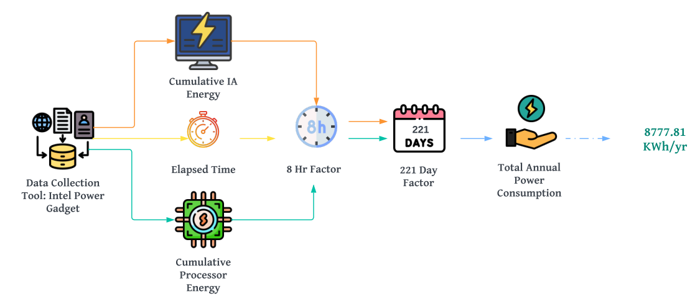

Annual Power Consumption

Slide 6
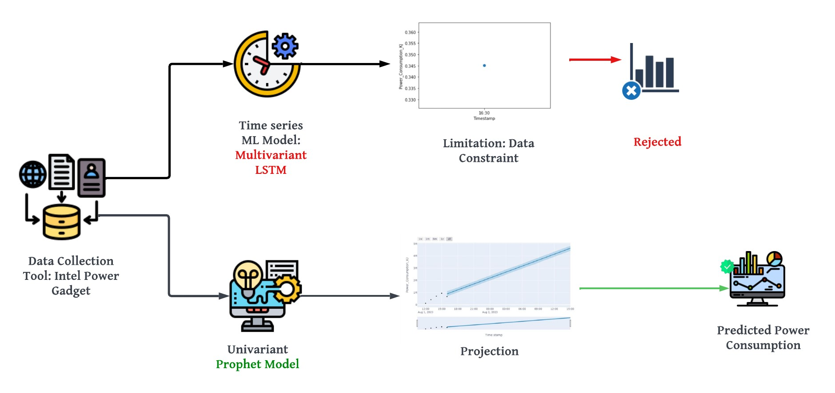
Machine Learning Model Flow

Slide 7

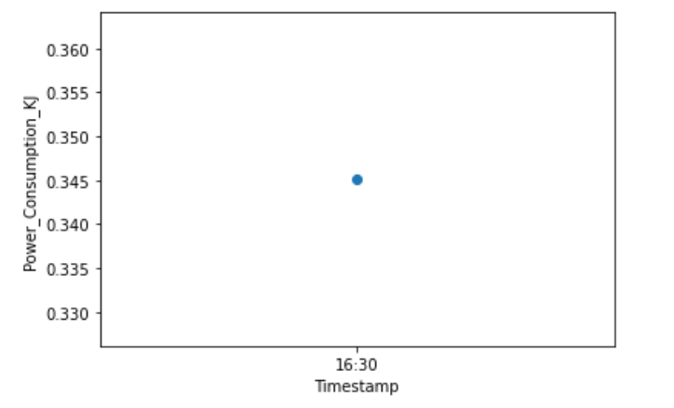
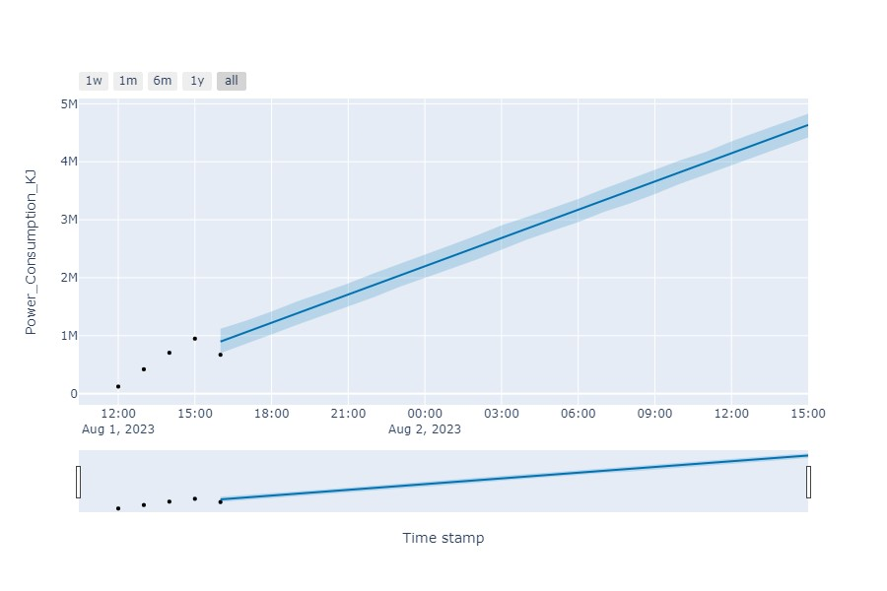
Multivariant LSTM
Univariant Prophet Model
Data Sampling & Preprocessing
Alternative to Dataset Constraints
Prophet Model Overview
1
Model Testing and Generalization
2
1
2
Ease of Use and Deployment
3
Predicting Future Values
3
Data Resampling for Enhancement
4
4
Challenges and Iterations
Evaluating Predictions and Graphical Representation
5

Slide 8
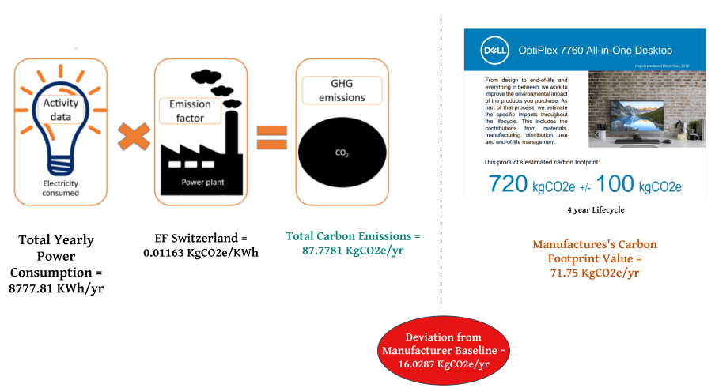
Carbon Emission Calculation

Slide 9
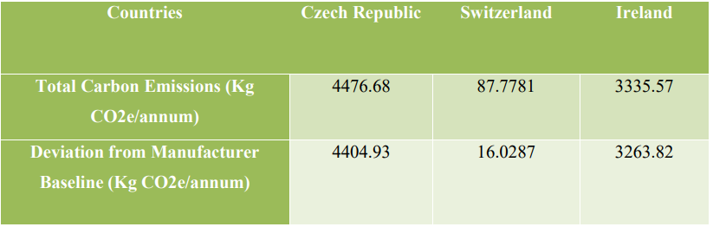
Diverse Global Impact: Varied Emissions Based on Product Location
Czech Republic : 4404.93 kgCO2e
Manufacturer's provided carbon footprint value
DEVIATION
Switzerland: 16.0287 kgCO2e
Ireland : 3263.82 kgCO2e
71.75 KgCO2e

Slide 10
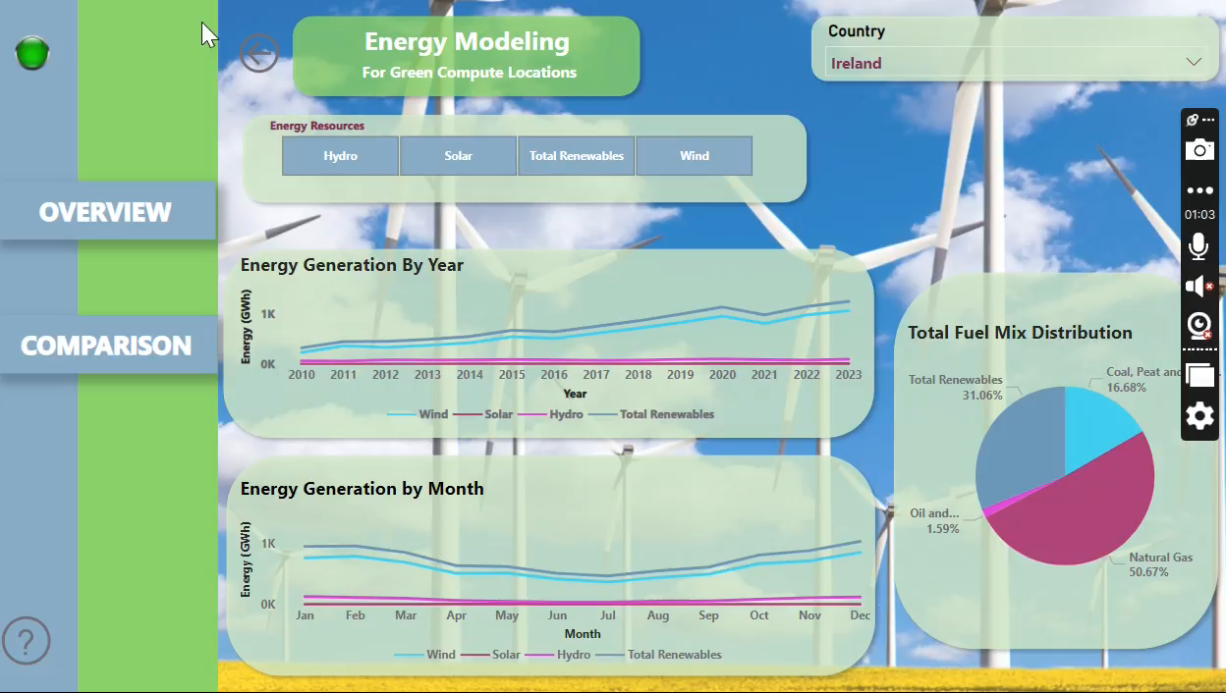
Energy Modelling Dashboard 1

Slide 11
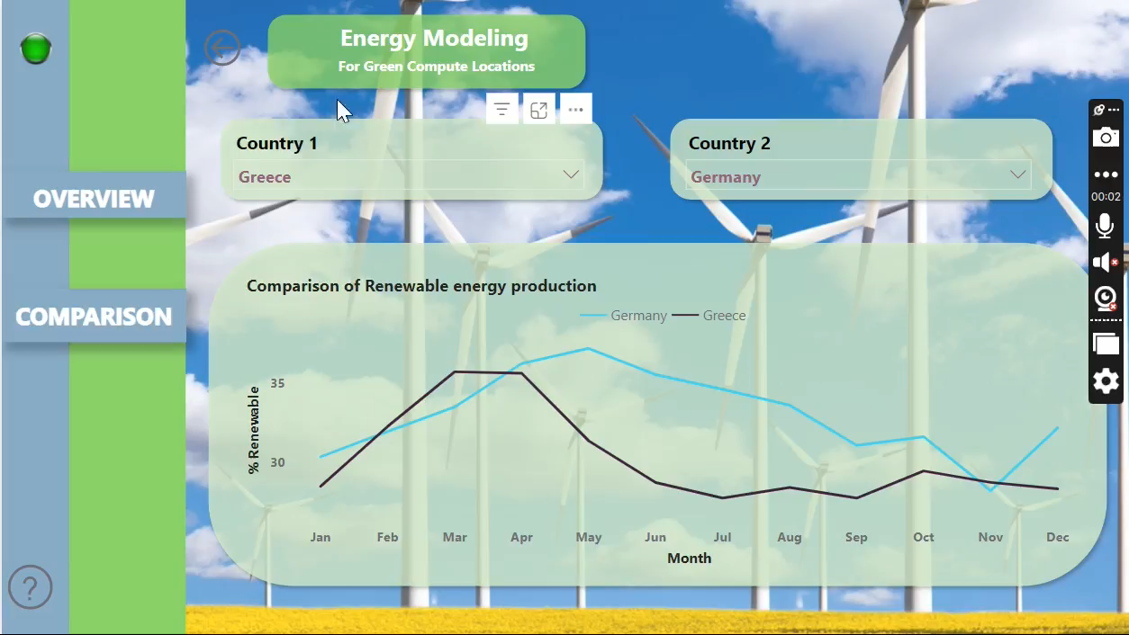
Country-wise Comparative Analysis Dashboard 2
Energy Modelling Dashboard 2

Slide 12
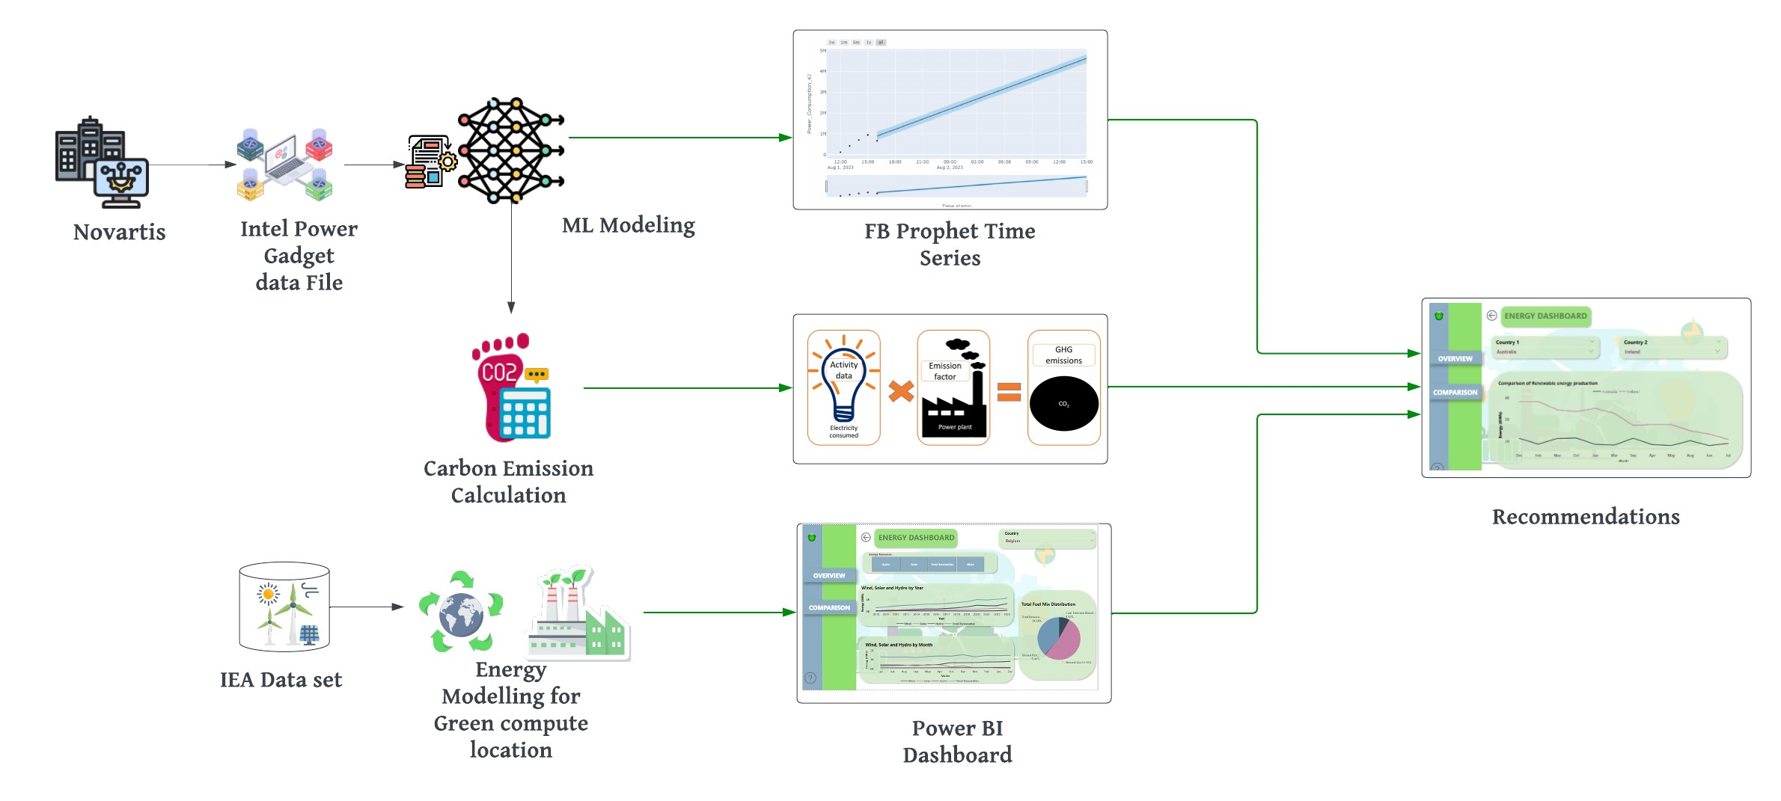
Business Process Flow

Slide 13
Recommendations
Machine Learning: Predicting Carbon Emissions for Sustainable Enterprise Strategies.
Power BI Dashboards: Analyzing Renewable Patterns to Boost Novartis' Sustainability and Efficiency.
Identifying the ideal times of the year to set up operations in each
country based on their renewable energy trends.

Slide 14
Future scope
Improve prediction accuracy using 6-10 years of diverse historical workload data
One-point solution that’s compatible with different models of the assets within the organization.
Achieve cost efficiencies by optimizing the allocation of resources.
Explore strategies to distribute computing tasks across locations, prioritizing the reduction of carbon footprint.

Slide 15
Thank You.
Pooja Dash

